Slide 1

Avinash Rao: Project Manager
Khalil Millwood: Android Developer
Ariana Santiago: Digital Artist
Steve Smodish: AR Developer

Slide 2
PURPOSE OF THE APPLICATION
To Guide Individuals To Think Healthy

Slide 3
PROJECT MANAGER
Defining and Understanding Scope
Dealing with lack of medical expertise
Preparing items for product presentation
Mayo Clinic’s format for Healthy Thinking
In charge of finding the information that was needed for the product.
Developing phases of healthy thinking: identifying negative thinking patterns, focusing on positive thinking, and practicing positive thinking.

Slide 4
ANDROID DEVELOPER
TabBarLayout
Each Tab is Fragment within the TabBarLayoutActivity
ViewPager
CardLayout
RecyclerView (More efficient than a ListView)
Adapter (ViewHolders, Layout Inflators)
Layout Manager (I used a LinearLayoutManager)
ExpandableRecyclerView (Big Shot Out to Big Nerd Ranch)
The adapter takes a List composed of other list and creates a parent-child relationship.

Slide 5
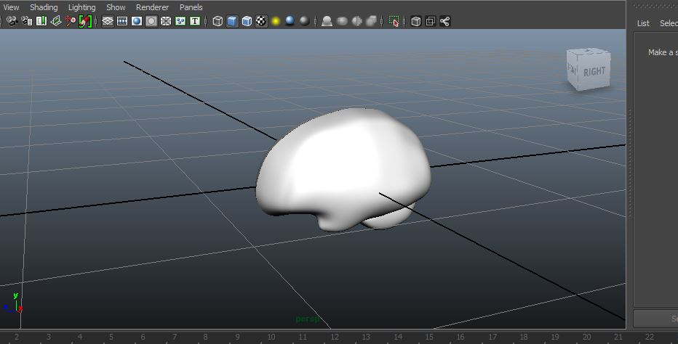
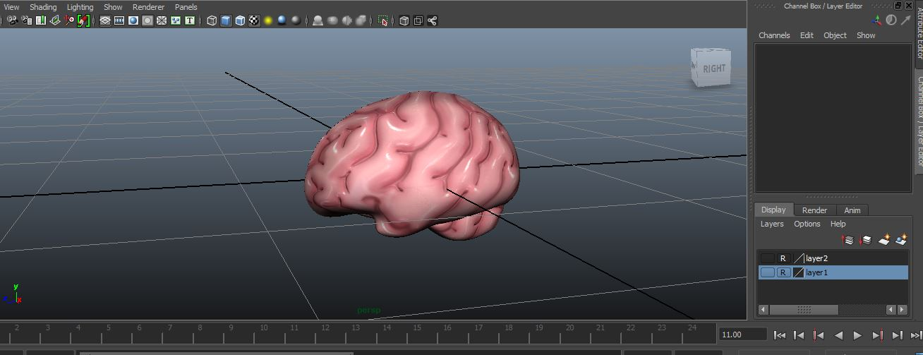
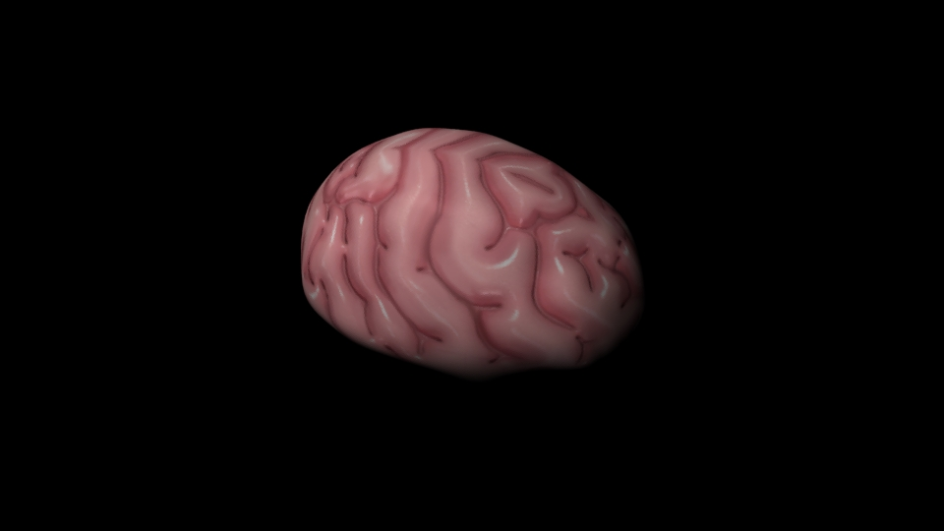
DIGITAL ARTIST

Slide 6
THINKING HEALTHY AR
What are the ways to create augmented reality on the android tablet?
Wikitude
ARToolkit
Vuforia (with or without unity)

Slide 7

INTERACTIVITY AND AUGMENTED REALITY
Off the shelf tools:
Unity – interactivity, access to android sensors, 3d modeling
Vuforia – camera tracking, model placement

Slide 8
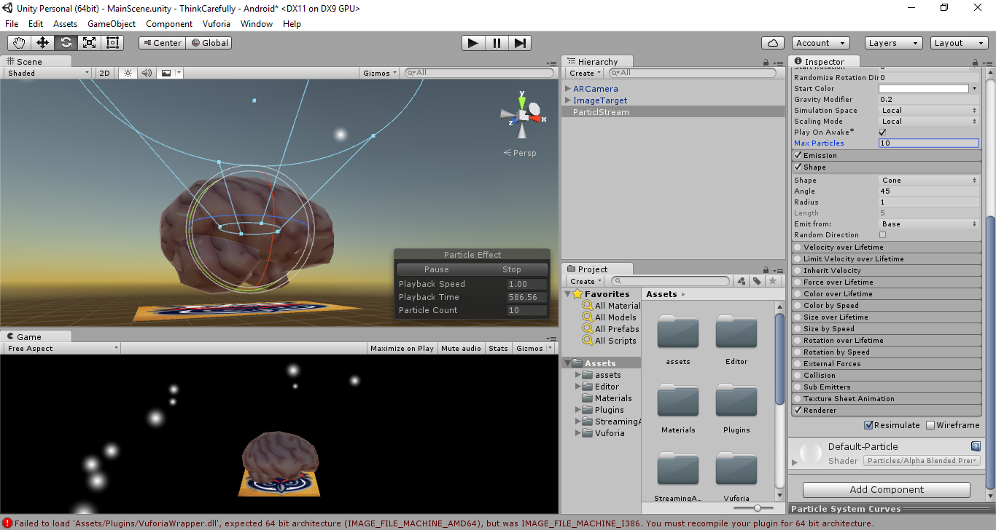

Slide 9
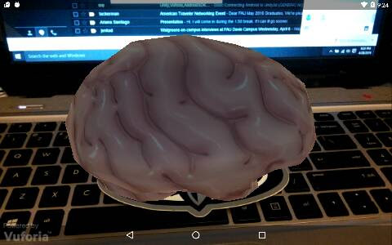

Slide 10
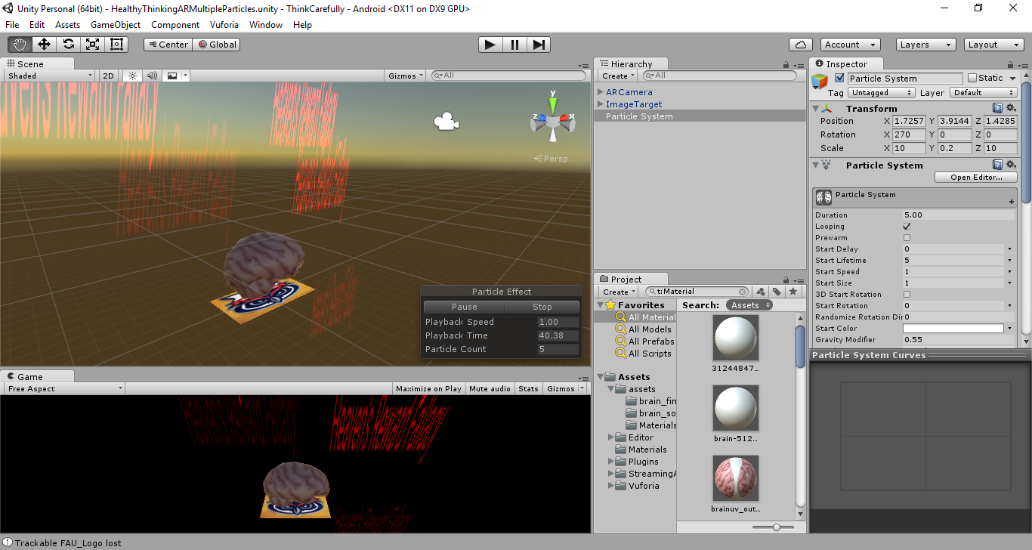
PARTICLE SYSTEMS

Slide 11


